Slide 1
Ph.D. Progress Presentation
Anup Gangwar

Slide 2
Presentation Outline
Introduction and motivation
Specialization opportunities in VLIW processors
Methodology
Integer Linear Programming model for DSE of VLIW ASIPs
Status of work
Future work
References

Slide 3
Introduction
Why customize architectures?
  General purpose computing domain Vs embedded
  Customization leads to cheaper design solutions
Architectural choices for exploiting ILP
  Superscalar processors
    Try to extract ILP at run time, so, complex hardware
    Limited clock speeds and high power dissipation
    Not suited for embedded type of applications
  VLIW processors
    Compiler has lot of knowledge about hardware
    Compiler extracts ILP statically, so, simplified hardware
    Possible to attain higher clock speeds

Slide 4
Introduction - Problems with VLIW Processors
Complex compiler required for extracting ILP
Adequate hardware support needed for compiler controlled execution
Code size expansion due to explicit NOPs if,
  The application does not contain enough parallelism
  The compiler is not able to extract parallelism from the application
  Good instruction encoding scheme is not used

Slide 5
Presentation Outline
Introduction and motivation
Specialization opportunities in VLIW processors
Methodology
Integer Linear Programming model for DSE of VLIW ASIPs
Status of work
Future work
References

Slide 6
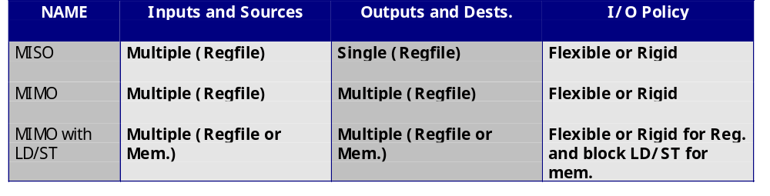
Specialization Opportunities -> FUs
Functional Unit Types
  MISO or Multiple Input Single Output
  MIMO or Multiple Input Multiple Output
  MIMO with LD/ST or MIMOs with memory interaction
  Rigid or flexible I/O timeshapes

Slide 7
Specialization Opportunities -> Reg. File
Single register file organization doesn’t scale well
  Area grows as N³
  Delay grows as N^{3/2}
  Power grows as N³
      where N is the no. of Functional Units connected to the register file
Clustered VLIW architectures are the solution
  Each FU can read from/write to only a subset of registers
  Data copying may increase execution latency
  Powerful application analysis required to overcome above mentioned problems

Slide 8
Specialization Opportunities -> Interconnect
Clustering FUs together requires deciding ICN
  between different clusters
  between clusters and memory
Analysis of data access patterns required for evaluating cost-performance tradeoffs
Current ASIP vendors do not offer customizable interconnects

Slide 9
Specialization Opportunities -> Encoding
Instruction encoding/decoding scheme affects
  Code size
  Object code compatibility
  Branch miss prediction penalty
  Hardware cost
  Address specification in code size
Each UniOp is equivalent to a RISC/CISC instruction
UniOp
UniOp
UniOp
UniOp
MultiOp

Slide 10
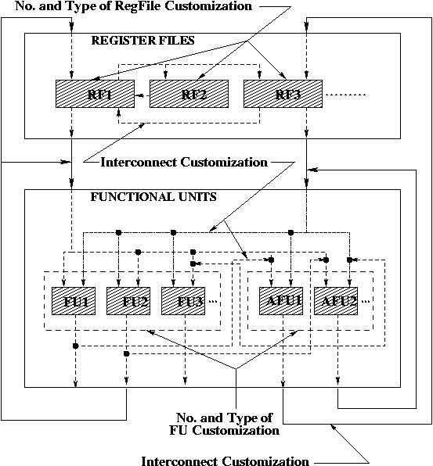
Specialization Opportunities -> Summary

Slide 11
Presentation Outline
Introduction and motivation
Specialization opportunities in VLIW processors
Methodology
Integer Linear Programming model for DSE of VLIW ASIPs
Status of work
Future work
References

Slide 12
Task Set and
Constraints
Architecture
Description
Application Parameter
Extraction
Architecture Design Space Exploration
Retargetable Compiler
Instruction Encoding Specialization
Validation
(Simulation with encoded instructions)
DSE Framework
Architecture Description
(Output to synthesizer)
Validation Framework
VLIW ASIP Synthesis Methodology

Slide 13
Presentation Outline
Introduction and motivation
Specialization opportunities in VLIW processors
Methodology
Integer Linear Programming model for DSE of VLIW ASIPs
Status of work
Future work
References

Slide 14
ILP Model for DSE of VLIW ASIPs
Assumptions:
  Latency is implicitly reflected in the RF cost
  Only one RF is present per cluster and all RFs are of the same word size (say integer)
  Values are not spilled to memory, however, instructions may get delayed due to insufficient number of ports
  FUs write values only to RF of the cluster to which they are bound, however, values may be read by multiple FUs

Slide 15
ILP Model for DSE of VLIW ASIPs (contd..)
Inputs:
  Schedule and (derived) value live ranges
  FU allocation and binding
  Library with RF Types (Size, Ports, Cost)
Outputs:
  No. of clusters
  FU to cluster binding
  Value to register-in-cluster binding
  Interconnect structure

Slide 16
ILP Model for DSE of VLIW ASIPs (contd..)
Generated Architecture
RF 0
RF 1

Slide 17
ILP Model for DSE of VLIW ASIPs (contd..)
Decision Variables
R_{nm} = 1 if RF `n’ from library is selected for cluster `m` else 0
VRC_{ilm} = 1 if value `i’ is bound to register `l’ of cluster `m’ else 0
FC_{jm} = 1 if FU `j’ is connected to RF of cluster `m’ else 0
FCc_{jm} = 1 if FU `j’ is connected to RF of cluster `m` else 0
RCu_{jm} = 1 if register `l’ of cluster `m’ is used else 0

Slide 18
ILP Model for DSE of VLIW ASIPs (contd..)
Constraint 1:
  No. of values being read in this cycle and which have been assigned a reg. in this reg. File
  <= No. of Read Ports
  No. of values being written to in this cycle and which have been assigned a reg. in this reg. File
  <= No. of Write Ports

Slide 19
ILP Model for DSE of VLIW ASIPs (contd..)
Constraint 2:
  The total number of all registers in RF of cluster (m) which have ever been used
  <= Size of RF of cluster (m)
Constraint 3:
  Each value is assigned one and only one register

Slide 20
ILP Model for DSE of VLIW ASIPs (contd..)
Constraint 4:
  Two values which are live cannot be assigned the same register at the same time step
Constraint 5:
  If a RF feeds a value to any FU ever then it needs to be connected to that FU

Slide 21
ILP Model for DSE of VLIW ASIPs (contd..)
Constraint 6:
  The FUs belonging to this cluster only can write to the RF of this cluster
Constraint 7:
  Any FU is assigned to only one cluster
Constraint 8:
  Each cluster contains exactly one RF

Slide 22
Presentation Outline
Introduction and motivation
Specialization opportunities in VLIW processors
Methodology
Integer Linear Programming model for DSE of VLIW ASIPs
Status of work
Future work
References

Slide 23
Status of Work
ILP Model
  Working on toy examples
  Excessive time being taken for large examples
Validation Framework:
  Framework for studying effects of instruction encoding schemes is in place
  Simple register allocation for clustered VLIW architectures is working fine
  Simulator for simulating with encoded instructions is a work-in-progress

Slide 24
Presentation Outline
Introduction and motivation
Specialization opportunities in VLIW processors
Methodology
Integer Linear Programming model for DSE of VLIW ASIPs
Status of work
Future work
References

Slide 25
Future Work
DSE for VLIW ASIPs:
  Run ILP model on large examples
  Work on FU specialization
  Automatic instruction encoding specialization
Validation Framework:
  More work needed on compiler backend
  Support for code generation for augmentations to ISA
  Some integration issues

Slide 26
Presentation Outline
Introduction and motivation
Specialization opportunities in VLIW processors
Methodology
Integer Linear Programming model for DSE of VLIW ASIPs
Status of work
Future work
References

Slide 27
References
Bhuvan Middha, Varun Raj, Anup Gangwar, M. Balakrishnan, Anshul Kumar and Paolo Ienne, “A Trimaran based framework for exploring design space of VLIW ASIPs with coarse grain FUs”, ISSS-2002.
Anup Gangwar, M. Balakrishnan and Anshul Kumar, “A framework for studying the effect of VLIW processor instruction encoding and decoding schemes”, Mini-Project Report, Dept. of CSE.
Garuv Bansal, Sachin Bansal, Anup Gangwar, M. Balakrishnan and Anshul Kumar, “VIES: A Simple and Compact Language for Representing Encoding of VLIW Instructions”, Mini-project Report, Dept. of CSE.
M. Jacome and G. de. Veciana, “Design challenges for new application specific processors”, IEEE Design and Test of Computers-2000.
B. Ramakrishna Rau and Michael S. Schlansker, “Embedded computer architecture and automation”, IEEE Computer-2001
Michael S. Schlansker and B. Ramakrishna Rau, “EPIC: An architecture for instruction-level parallel processors”, HPCA-2000.
N. G. Busa, A. van der Werf and M. Bekooij, “Scheduling coarse grain operations for VLIW processors”, ASPDAC-1998.
Shail Aditya, Scott A. Mahlke and B. Ramakrishna Rau, “Code size minimization and retargetable assembly for custom EPIC and VLIW processors”, ISSS-1999.

